Slide 1

Day 2
- Subramanya Joshi

Slide 2
Agenda
Introduction
Intro to Ambari Metrics Collection architecture
Problem with HDF – Ambari Metrics Collection
Performance bottlenecks
Possible Solutions

Slide 3
Introduction
Ambari Metrics Collection service stopped at 01:15:00 AM CET
2019-11-07 01:15:32,665 INFO org.apache.ambari.metrics.AMSApplicationServer: SHUTDOWN_MSG:
/************************************************************
SHUTDOWN_MSG: Shutting down AMSApplicationServer at l5706t.sss.se.scania.com/138.106.41.17
************************************************************/

Slide 4
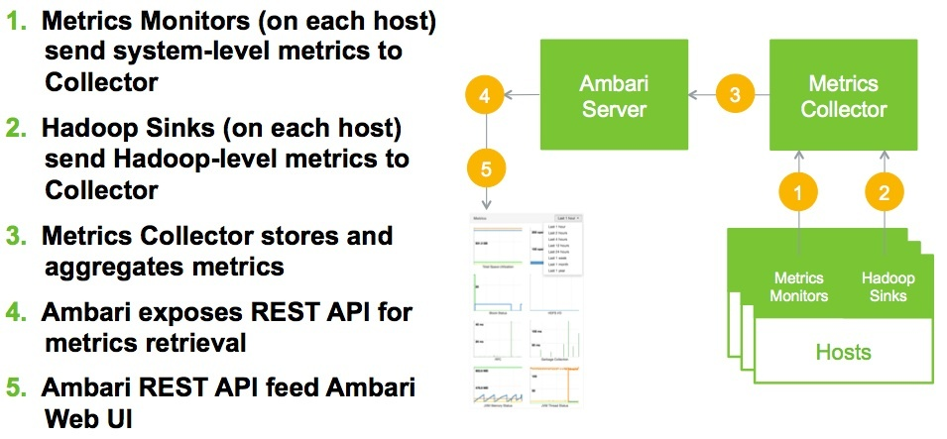
Intro to Ambari Metrics Collection architecture

Slide 5
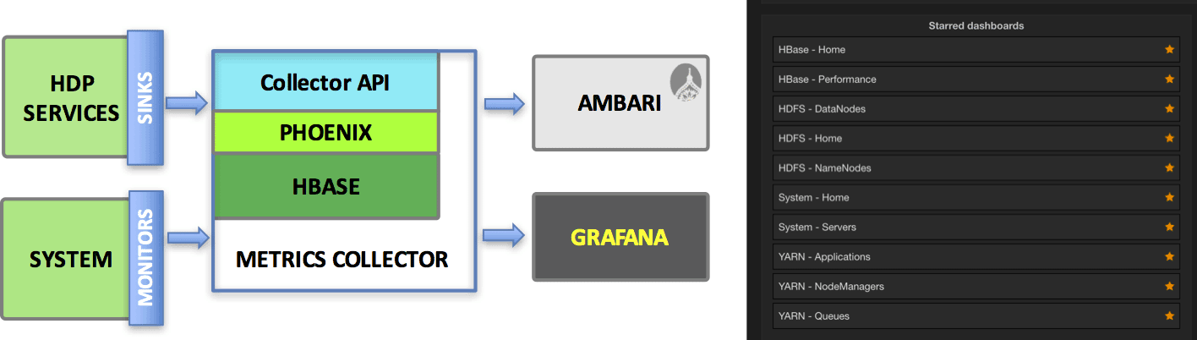
Intro to Ambari Metrics Collection architecture

Slide 6
Intro to Ambari Metrics Collection architecture
Ambari Metrics System is a system for collecting, aggregating and serving Hadoop and system metrics in Ambari-managed clusters.
The Metrics Collector is daemon that receives data from registered hosts.
The Collector is build using Hadoop technologies such as HBase Phoenix and ATS.
The Collector can store data on the local filesystem or use an external HDFS.

Slide 7
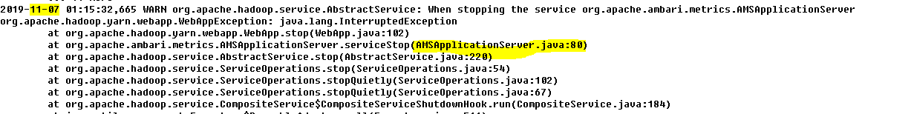
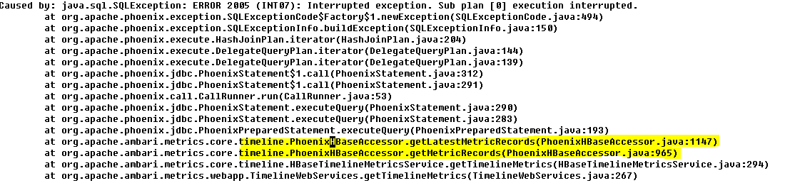
Problem with HDF – Ambari Metrics Collection

Slide 8
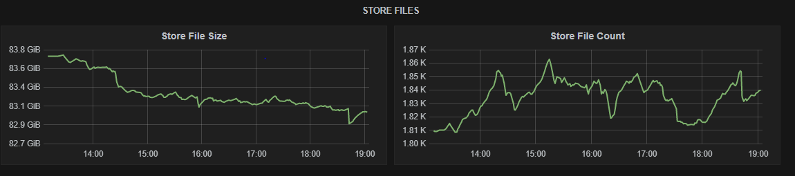
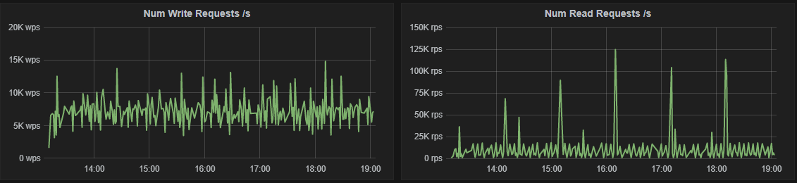
Problem with HDF – Ambari Metrics Collection

Slide 9
Performance bottlenecks
Hbase
Too slow
Not responding for query
Index files occupying more memory
Hbase Phoenix client time outs and Ambari metrics application crashed

Slide 10
Performance bottlenecks
Generally
Database
Network
Stateful services
Disk or any IO devices

Slide 11
Solution
Make Hbase distributed
Reduce database retention of metrics
Scaling out ambari metrics collection webapp
Scaling-in HBase

Slide 12
Thank You

